Slide 1
Lecture-11
Perception of Sound

Slide 2
Speech Perception
Understanding how we hear sounds and how we perceive speech → better design and implementation of robust and efficient systems for analyzing and representing speech
the better we understand signal processing in the human auditory system, the better we can (at least in theory) design practical speech processing systems like:
– speech coding
– speech recognition
Try to understand speech perception by looking at the physiological models of hearing

Slide 3
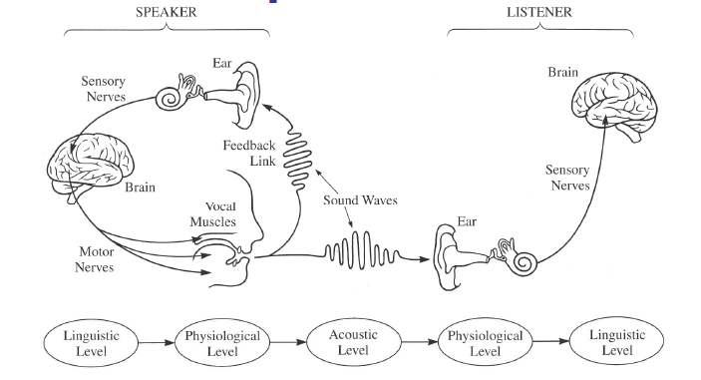
The Speech Chain
The Speech Chain comprises the processes of:
Speech production,
Auditory feedback to the speaker,
Speech transmission (through air or over an electronic
Communication system (to the listener), and
Speech perception and understanding by the listener.

Slide 4
The Speech Chain
The message to be conveyed by speech goes through five levels of representation between the speaker and the listener
the linguistic level (where the basic sounds of the communication are chosen to express some thought of idea)
the physiological level (where the vocal tract components produce the sounds associated with the linguistic units of the utterance)
the acoustic level (where sound is released from the lips and nostrils and transmitted to both the speaker (sound feedback) and to the listener
the physiological level (where the sound is analyzed by the ear and the auditory nerves), and finally
the linguistic level (where the speech is perceived as a sequence of linguistic units and understood in terms of the ideas being communicated)

Slide 5
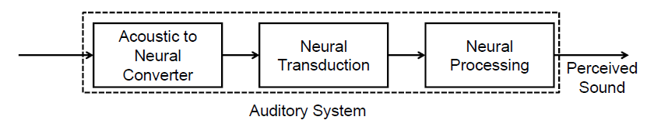
The Auditory System
The acoustic signal first converted to a neural representation by processing in the ear
The conversion takes place in stages at the outer, middle and inner ear
These processes can be measured and quantified
The neural transduction step takes place between the output of the inner ear and the neural pathways to the brain
Consists of a statistical process of nerve firings at the hair cells of the inner ear, which are transmitted along the auditory nerve to the brain
Much remains to be learned about this process
The nerve firing signals along the auditory nerve are processed by the brain to create the perceived sound corresponding to the spoken utterance
These processes not yet understood

Slide 6
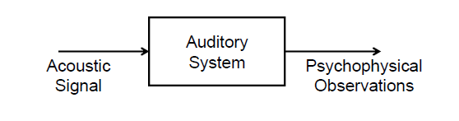
The Black Box Model of the Auditory System
Researchers have resorted to a “black box” behavioral model of hearing and perception
Model assumes that an acoustic signal enters the auditory system causing behavior that we record as psychophysical observations
Psychophysical methods and sound perception experiments determine how the brain processes signals with different loudness levels, different spectral characteristics, and different temporal properties
Characteristics of the physical sound are varied in a systematic manner and the psychophysical observations of the human listener are recorded and correlated with the physical attributes of the incoming sound
Then determine how various attributes of sound (or speech) are processed by the auditory system

Slide 7
Why Do We Have Two Ears
Sound localization – spatially locate sound sources in 3-dimensional sound fields
Sound cancellation – focus attention on a ‘selected’ sound source in an array of sound sources – ‘cocktail party effect’
Effect of listening over headphones => localize sounds inside the head (rather than spatially outside the head)

Slide 8
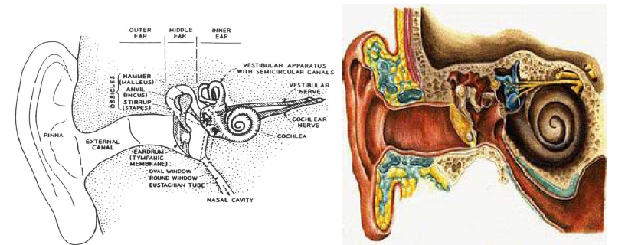
The Human Ear
Outer ear: pinna and external canal
Middle ear: tympanic membrane or eardrum
Inner ear: cochlea, neural connections

Slide 9
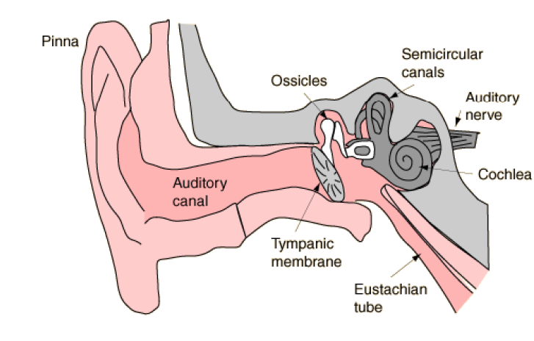
Ear and Hearing

Slide 10
Human Ear
Outer ear: funnels sound into ear canal
Middle ear: sound impinges on tympanic membrane; this causes motion
Middle ear is a mechanical transducer, consisting of the hammer, anvil and stirrup; it converts acoustical sound wave to mechanical vibrations along the inner ear
Inner ear: the cochlea is a fluid-filled chamber partitioned by the basilar membrane
The auditory nerve is connected to the basilar membrane via inner hair cells
Mechanical vibrations at the entrance to the cochlea create standing waves (of fluid inside the cochlea) causing basilar membrane to vibrate at frequencies commensurate with the input acoustic wave frequencies (formants) and at a place along the basilar membrane that is associated with these frequencies

Slide 11
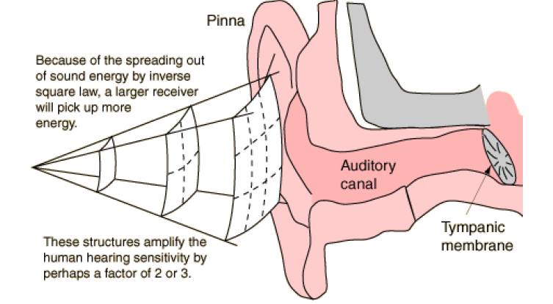
The Outer Ear

Slide 12
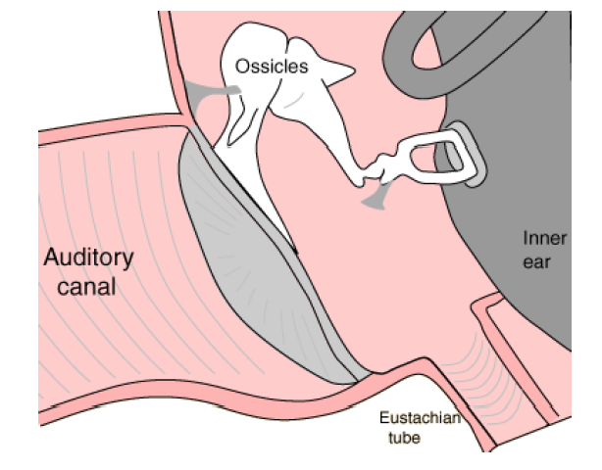
The Outer Ear

Slide 13
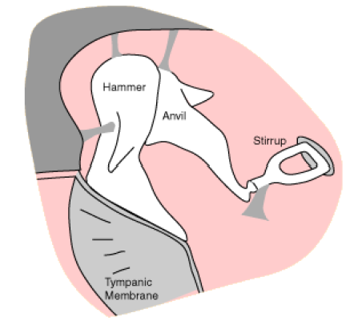
The Middle Ear
The Hammer (Malleus), Anvil (Incus) and Stirrup (Stapes) are the three tiniest bones in the body. Together they form the coupling between the vibration of the eardrum and the forces exerted on the oval window of the inner ear.
These bones can be thought of as a compound lever which achieves a multiplication of force—by a factor of about three under optimum conditions. (They also protect the ear against loud sounds by attenuating the sound.)

Slide 14
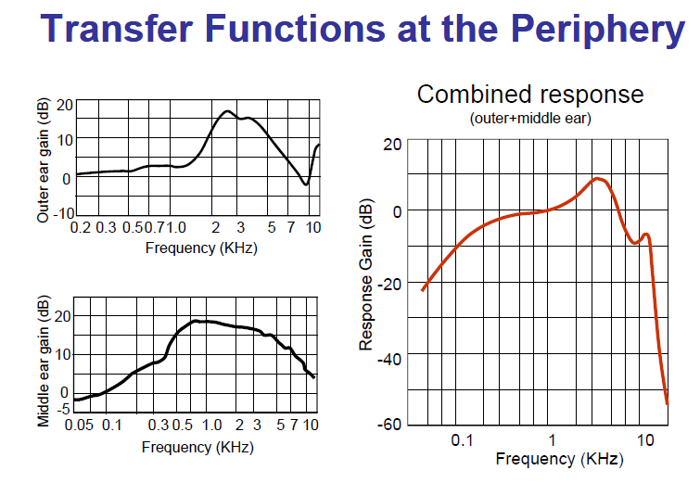

Slide 15
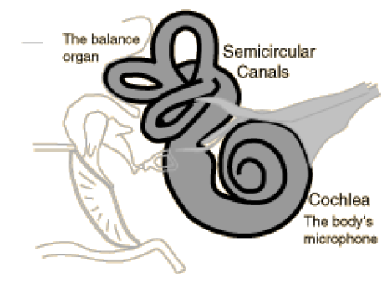
The Inner Ear
The inner ear can be thought of as two organs, namely the semicircular canals which serve as the body’s balance organ and the cochlea which serves as the body’s microphone, converting sound pressure signals from the outer ear into electrical impulses which are passed on to the brain via the auditory nerve.

Slide 16
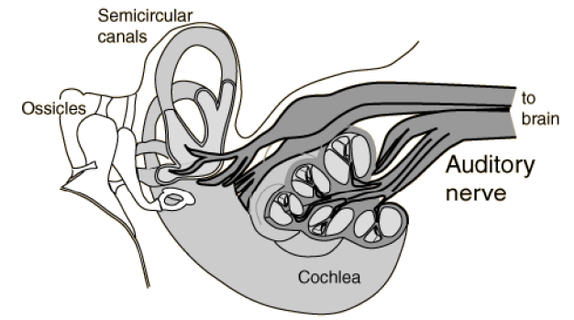
The Auditory Nerve
Taking electrical impulses from the cochlea and the semicircular canals, the auditory nerve makes connections with both auditory areas of the brain.

Slide 17
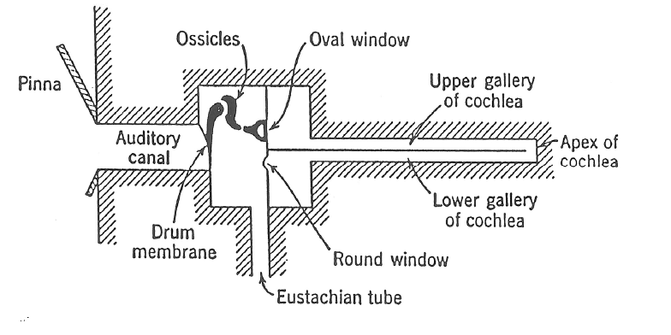
Schematic Representation of the Ear

Slide 18
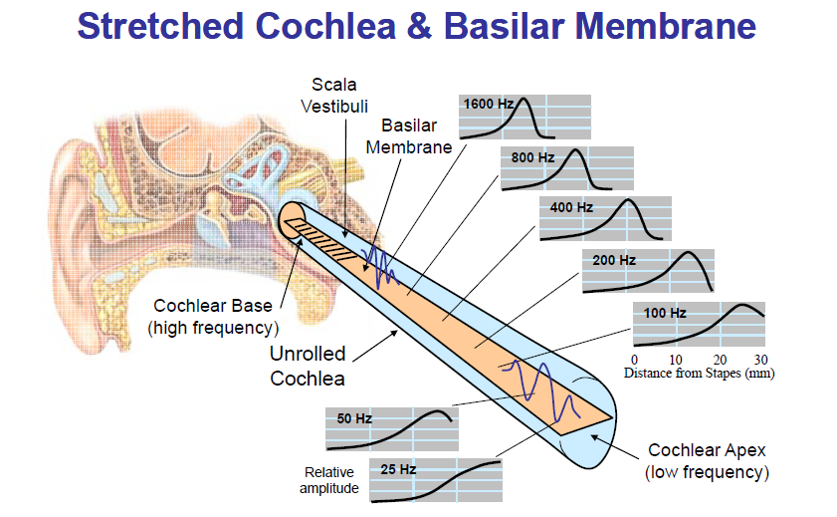

Slide 19
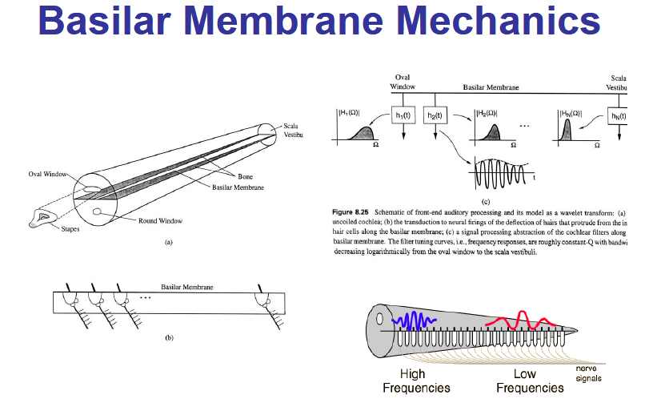

Slide 20
Basilar Membrane Mechanics
Characterized by a set of frequency responses at different points along the membrane
Mechanical realization of a bank of filters
Filters are roughly constant Q (center frequency/bandwidth) with logarithmically decreasing bandwidth
Distributed along the Basilar Membrane is a set of sensors called Inner Hair Cells (IHC) which act as mechanical motion-to-neural activity converters
Mechanical motion along the BM is sensed by local IHC causing firing activity at nerve fibers that innervate bottom of each IHC
Each IHC connected to about 10 nerve fibers, each of different diameter => thin fibers fire at high motion levels, thick fibers fire at lower motion levels
30,000 nerve fibers link IHC to auditory nerve
Electrical pulses run along auditory nerve, ultimately reach higher levels of auditory processing in brain, perceived as sound

Slide 21
Basilar Membrane Motion
The ear is excited by the input acoustic wave which has the spectral properties of the speech being produced
Different regions of the BM respond maximally to different input frequencies => frequency tuning occurs along BM
The BM acts like a bank of non-uniform cochlear filters
Roughly logarithmic increase in BW of filters (<800 Hz has equal BW) => constant Q filters with BW decreasing as we move away from cochlear opening
Peak frequency at which maximum response occurs along the BM is called the characteristic frequency

Slide 22
The Perception of Sound
Key questions about sound perception:
What is the `resolving power’ of the hearing mechanism
How good an estimate of the fundamental frequency of a sound do we need so that the perception mechanism basically can’t tell the difference
How good an estimate of the resonances or formants (both center frequency and bandwidth) of a sound do we need so that when we synthesize the sound, the listener can’t tell the difference
How good an estimate of the intensity of a sound do we need so that when we synthesize it, the level appears to be correct

Slide 23
The Range of Human Hearing
Human hearing perceives both sound frequency and sound direction
Threshold of hearing — Thermal limit of Brownian motion of air particles in the inner ear
The acoustic intensity level of a pure tone that can barely be heard at a particular frequency is called Threshold of Audibility
threshold of audibility ≈ 0 dB at 1000 Hz
threshold of feeling ≈ 120 dB
threshold of pain ≈ 140 dB
immediate damage ≈ 160 dB
Thresholds vary with frequency and from person-to-person
Masking is the phenomenon whereby one loud sound makes another softer sound inaudible
masking is most effective for frequencies around the masker frequency

Slide 24
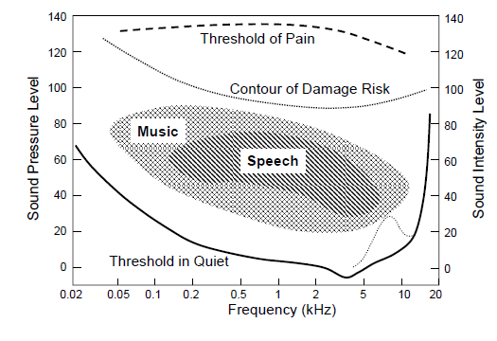
Range of Human Hearing

Slide 25
Sound Intensity
Intensity of a sound is a physical quantity that can be measured and quantified
Acoustic Intensity (I) defined as the average flow of energy (power) through a unit area, measured in watts/square meter
Threshold of hearing defined to be: I₀=10⁻¹² watts/m²
The intensity level of a sound I_{L} is defined relative to I₀
I_{L} =10 log₁₀I/I₀

Slide 26
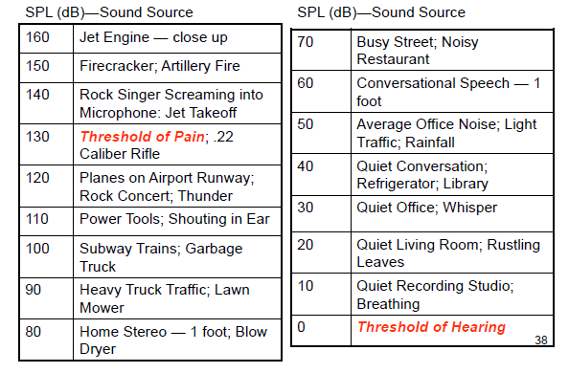
Sound Pressure Levels (dB)

Slide 27
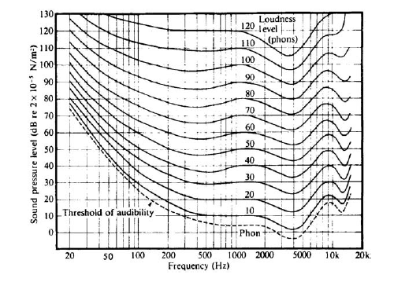
Loudness
Loudness is a perceptual quality that is related to the physical property of sound pressure level.
Loudness is quantified by relating the actual sound pressure level of a pure tone (in dB relative to a standard reference level) to the perceived loudness of the same tone (in a unit called phons) over the range of human hearing (20 Hz–20 kHz)

Slide 28
Loudness (L) in sones is a scale that doubles whenever the perceived loudness doubles
log (L) =0.033(L_{L}-40)
For a frequency of 1000 Hz, the loudness level, LL, in phons is, by definition, numerically equal to the intensity level IL in decibels,
L_{L}=I_{L} =10 log₁₀I/I₀
I₀=10⁻¹² watts/m²
log (L) =0.33logI+2.64
L=445I^{0.33}

Slide 29
Perception of Frequency
Pure tone
Pitch is a perceived quantity while Frequency is a physical one (cycle per second or Hertz)
Mel is a scale that doubles whenever the perceived pitch doubles;
start with 1000 Hz = 1000 mel, increase frequency of tone until listener perceives twice the pitch (or decrease until half the pitch) and so on to find mel-Hz relationship
The relationship between pitch and frequency is non-linear

Slide 30
Complex sound such as speech
Pitch is related to fundamental frequency but not the same as fundamental frequency; the relationship is more complex than pure tones

Slide 31
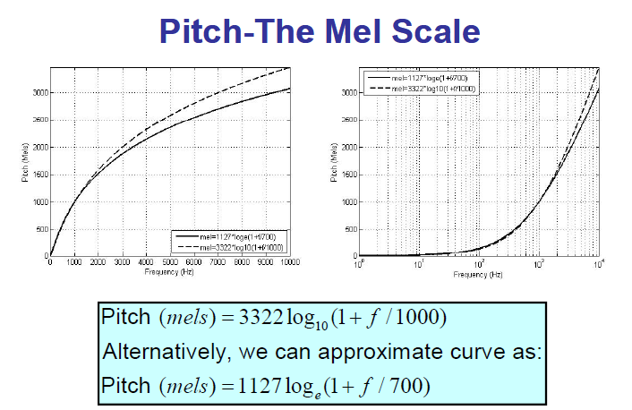

Slide 32
Parameter Discrimination
JND-Just Noticeable Difference
S/l | Parameter | JND
1 | Fundamental frequency | 0.3-0.5%
2 | Formant frequency | 3-5%
3 | Formant bandwidth | 20-40%
4 | Overall Intensity | 1.5 dB

Slide 33
Masking
Masking occurs when one sound makes a second superimposed sound inaudible. Loud tones causing strong vibrations at a point on the basilar membrane can swamp out vibrations that occur nearby.

Slide 34
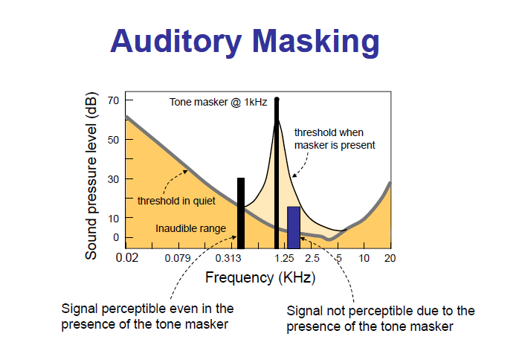

Slide 35

Critical Bands
The ear cannot distinguish sounds within the same band that occur simultaneously.
Each band is called a critical band
The auditory system can be roughly modeled as a filterbank, consisting of 25 overlapping bandpass filters, from 0 to 20 KHz
The bandwidth of each critical band is about 100 Hz for signals below 500 Hz, and increases non-linearly after 500 Hz up to 5000 Hz
1 bark = width of 1 critical band

Slide 36
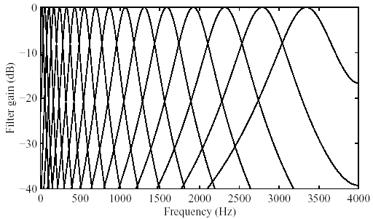
Critical Bands in Masking
Critical bands: The widths of the masking bands for different masking tones are different, increasing with the frequency of the masking tone.

Slide 37
Cochlea-Overlapping Bandpass Filter
A frequency-to-place transformation takes place in the cochlea (inner ear), along the basilar membrane.
Distinct regions in the cochlea, each with a set of neural receptors, are “tuned” to different frequency bands.
In fact, the cochlea can be viewed as a bank of highly overlapping band-pass filters.
The magnitude responses are asymmetric and non-linear (level-dependent).
Moreover, the cochlear filter pass-bands are of non-uniform bandwidth, and the bandwidths increase with increasing frequency.
The “critical bandwidth” is a function of frequency that quantifies the cochlear filter pass-bands.

Slide 38

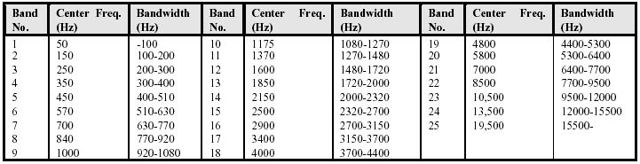
Cochlea-Overlapping Bandpass Filter
A distance of 1 critical band is commonly referred to as “one bark” in the literature.

Slide 39
Different Views of Auditory Perception
Functional: based on studies of psychophysics – relates stimulus (physics) to perception (psychology): e.g. frequency in Hz. vs. Mel/Bark scale.
Sensation or Perception
Stimulus
Auditory system
Black Box
Structural: based on studies of physiology/anatomy – how various body parts work with emphasis on the process; e.g. neural processing of a sound

Slide 40
Perceptual effects included in most auditory models
Spectral analysis on a non-linear frequency scale (usually mel or Bark scale)
Spectral amplitude compression (dynamic range compression)
Loudness compression via some logarithmic process
Decreased sensitivity at lower (and higher) frequencies based on results from equal loudness contours
Utilization of temporal features based on long spectral integration intervals (syllabic rate processing)
Auditory masking by tones or noise within a critical frequency band of the tone (or noise)

Slide 41
Auditory Models
Perceptual Linear Prediction
Seneff Auditory Model
Lyon’s Cochlear Model
Gamma tone Filter Bank Model for Inner Ear
Inner Hair Cell Model

Slide 42
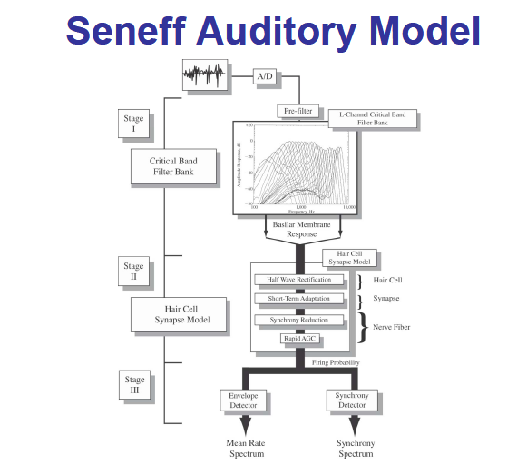

Slide 43
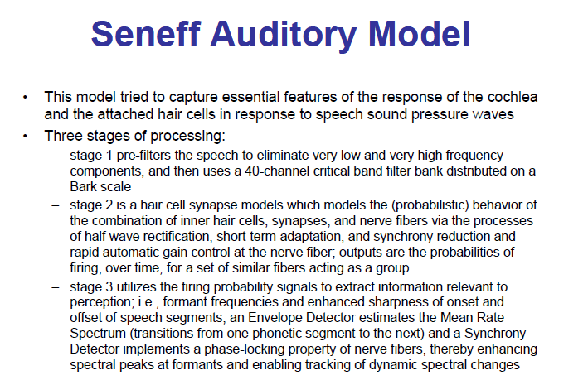

Slide 44
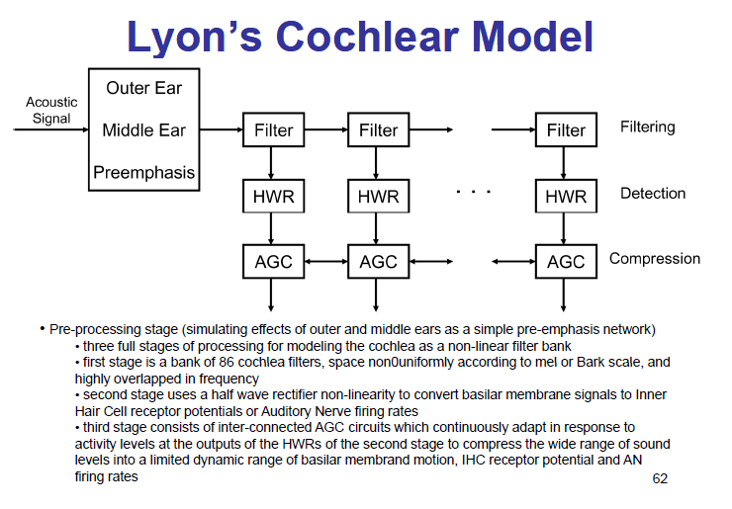

Slide 45
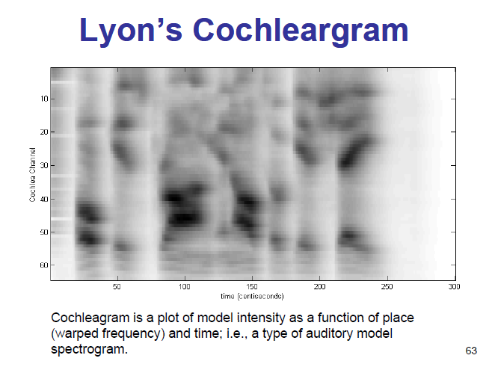

Slide 46
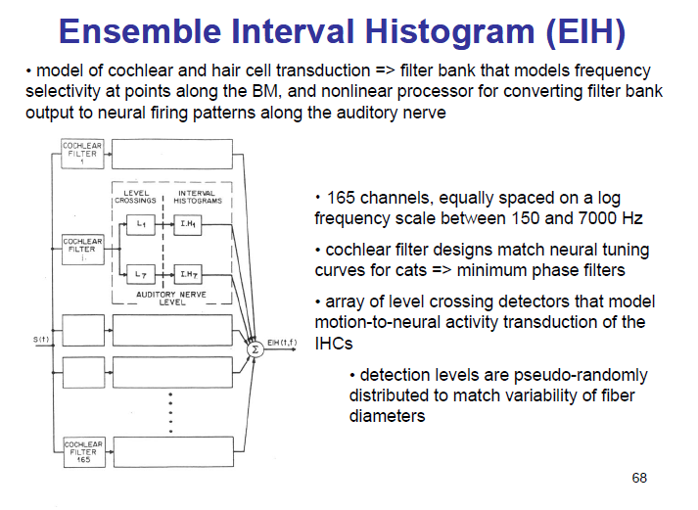

Slide 47
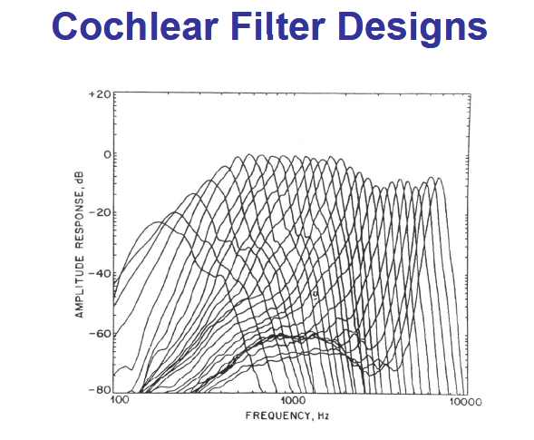

Slide 48
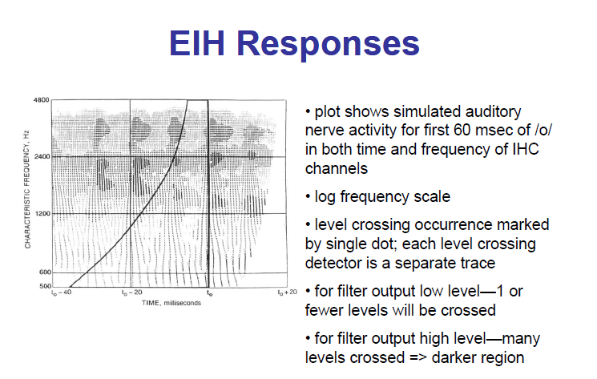

Slide 49
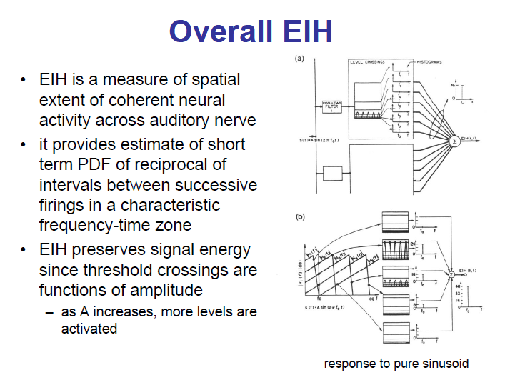

Slide 50
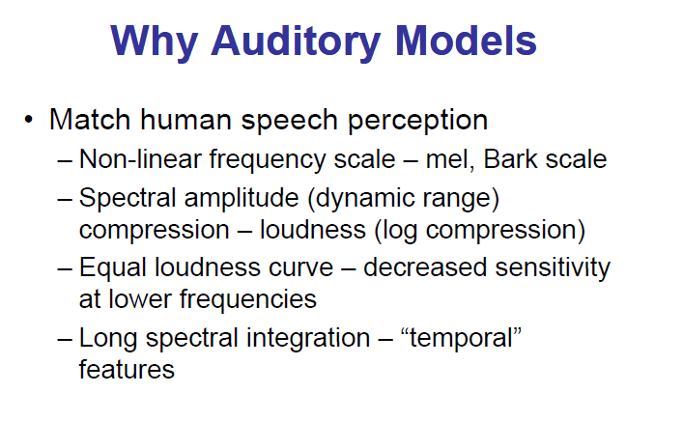

Slide 51
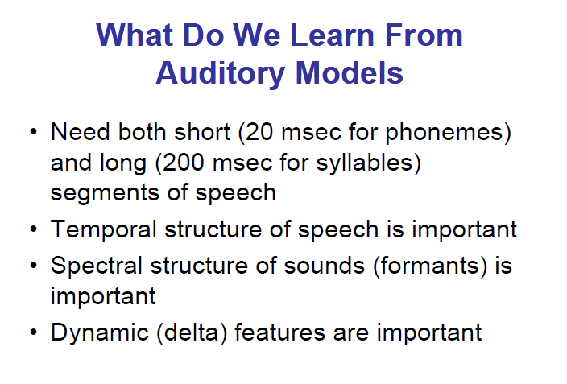

Slide 52
END

